Slide 1
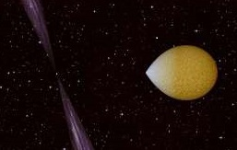
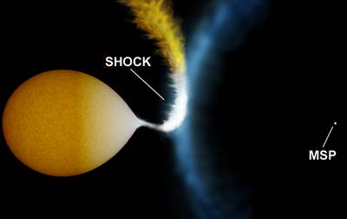
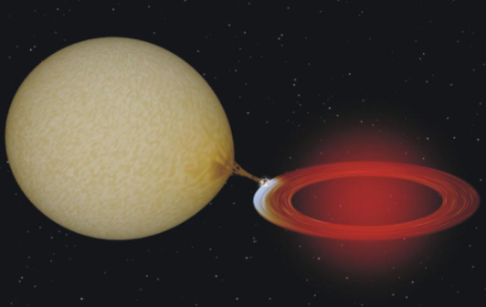
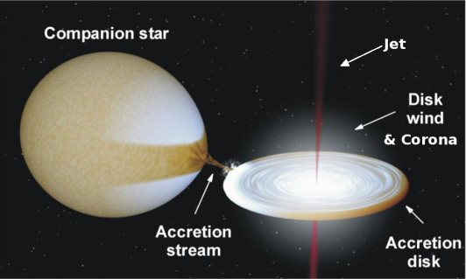
Neutron star metamorphosis X-ray states of “redback” millisecond pulsars
Altamirano, Bahramian, Bogdanov, Casares, Heinke, Homan, Miles-Paez, Palomo, Patruno, Pooley, Rodriguez-Gil, Shahbaz, Wijnands
Manu Linares – IAC, Spain

Slide 2
INCREASING X-RAY LUMINOSITY
Log(Lx;erg/s): 31-32
33-34
35-37
IRRADIATION!
MODE
SWITCHING!
(Rotation-powered)
PULSAR
STATE
(Rotation?/Accretion)
DISK
STATE
(Accretion-powered)
OUTBURST
STATE

Slide 3
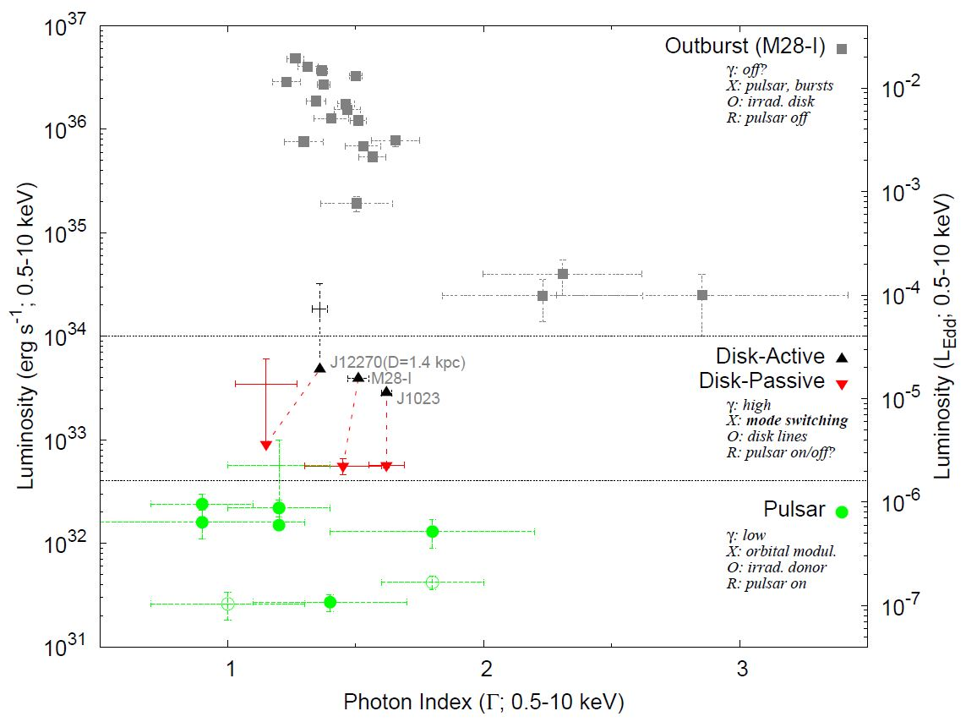
X-ray states of redbacks
Pulsar, disk(active/passive) and outburst states
Linares (2014, ApJ, 795,72)
~10³⁴ erg/s
(~Edot)
INCREASING X-RAY LUMINOSITY
~4x10³² erg/s
Three main states. Disk state at the crossroads between accretion and rotation power

Slide 4
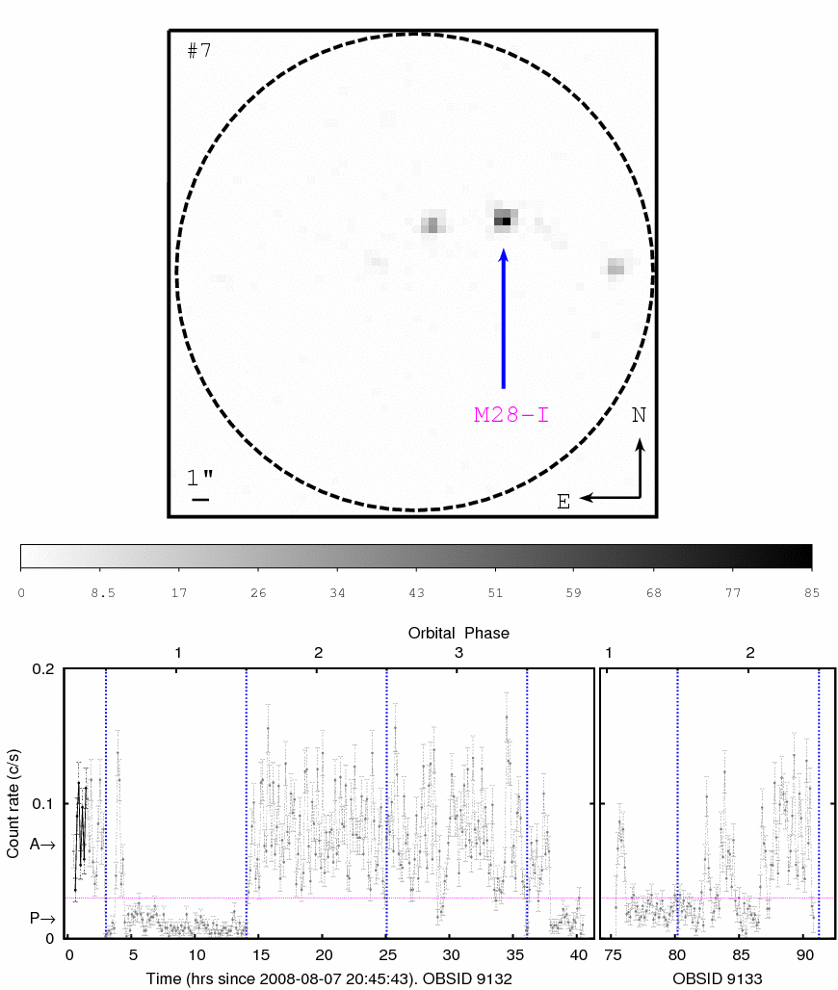
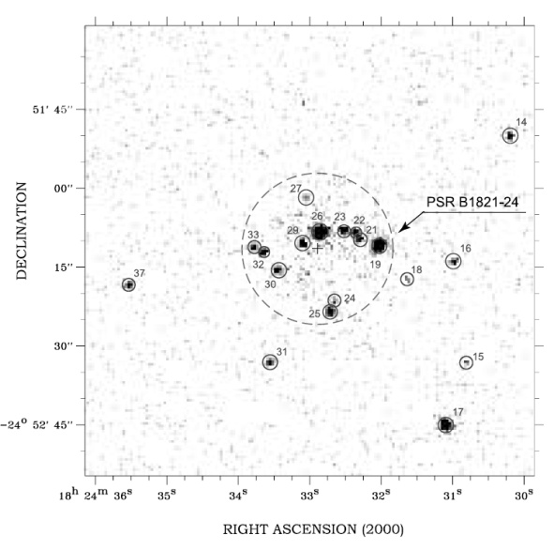
1-hr ACIS snapshots of M28’s core (14.4” radius)
Becker+03, Bogdanov+11
Chandra revealed striking variability from M28-I!
Fast (<500s) transitions between disk-active (L_{X}=3.9×10³³ erg/s) and disk-passive (L_{X}=5.6×10³² erg/s) states, both non-thermal (Γ=1.5)
Linares+ (2014, MNRAS, 438,251)

Slide 5
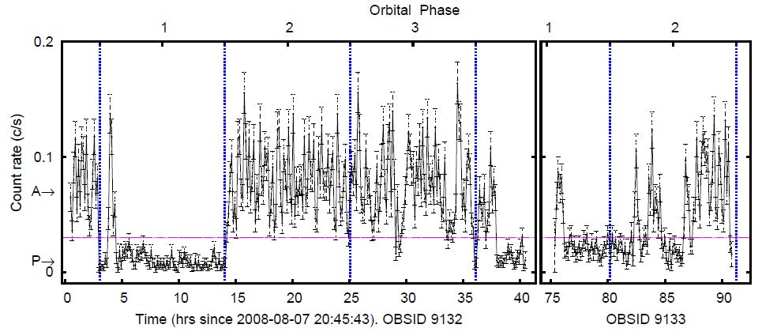
Disk state: mode switching (M28-I)
At the boundary between accretion and rotation power
10³² erg/s
^{Rotation power?}
10³³ erg/s
^{Accretion power}
Balance (tug-of-war) between accretion flow and pulsar wind?
Light cylinder radius at 186 km. For a 10⁸ G magnetic field:
Active states (L_{bol}=1.2×10³⁴ erg/s → R_{m}~130km): magnetospheric accretion.
Passive states (L_{bol}=1.7×10³³ erg/s → R_{m}~230 km): pulsar wind shock.

Slide 6
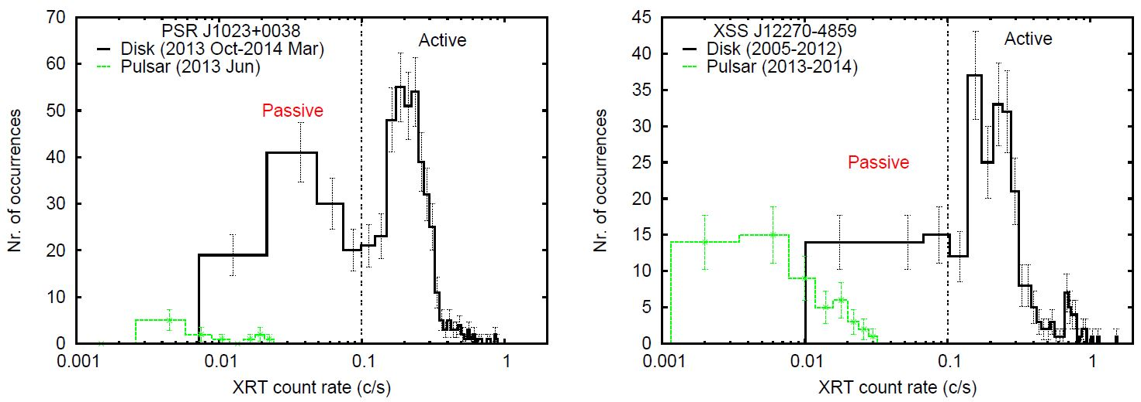
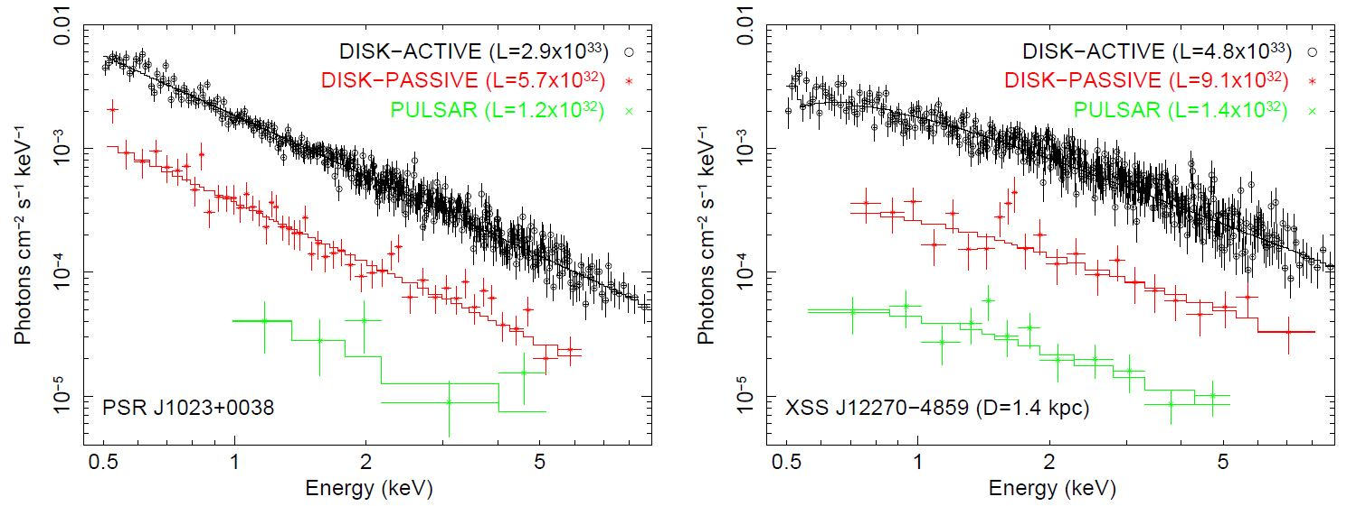
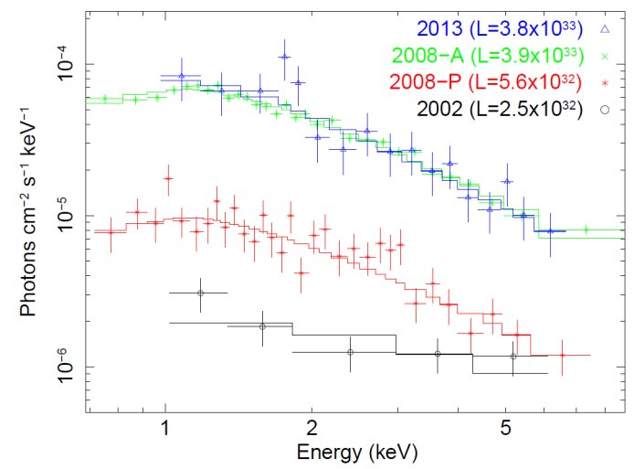
Disk state: mode switching (ALL)
Swift finds mode switching in J1023 & J12270
Linares14, ApJ
J1023 ✓
J12270 ✓
M28-I ✓
3/3 accreting redbacks show mode switching!
(“classical” transient NS-LMXBs don’t)
+J1544 ✓
(Bogdanov&Halpern’15)

Slide 7
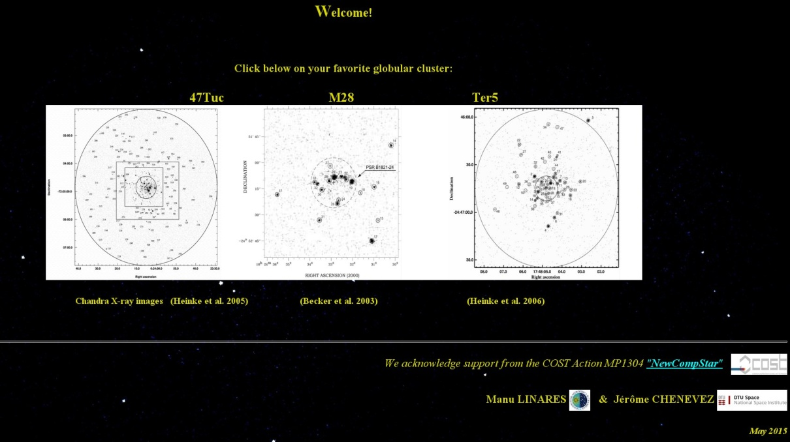
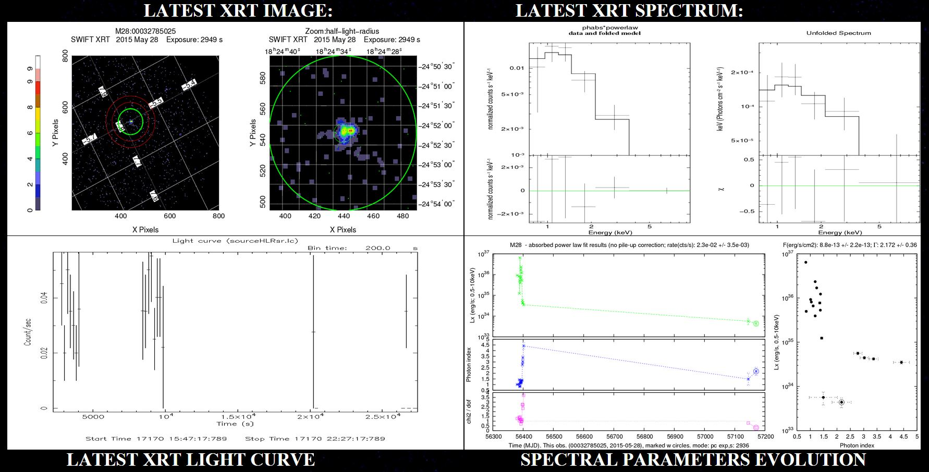
M28-I: Updates 2015
GBT: time; CHANDRA: resolve; SWIFT: monitor
Swift-XRT May 28 (half-light radius):
Lx=4e33 erg/s
Chandra-ACIS May 30 (M28-I only):
Lx=2e32 erg/s (PULSAR state)
GBT May 30:
Radio pulsar ON (?)
http://www.iac.es/proyecto/SwiftGloClu

Slide 8
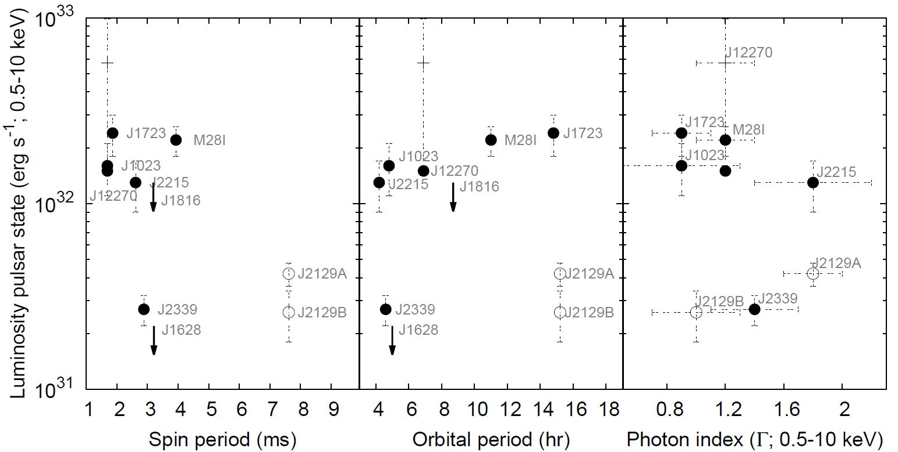
Pulsar state: who’s next?
Luminosity of the pulsar state: tracing the pulsar wind shock?
Linares (2014, ApJ, 795,72)
Accreting redbacks: relatively luminous pulsar state
(same is true for J1723 & J2215: good candidates to develop disks)

Slide 9
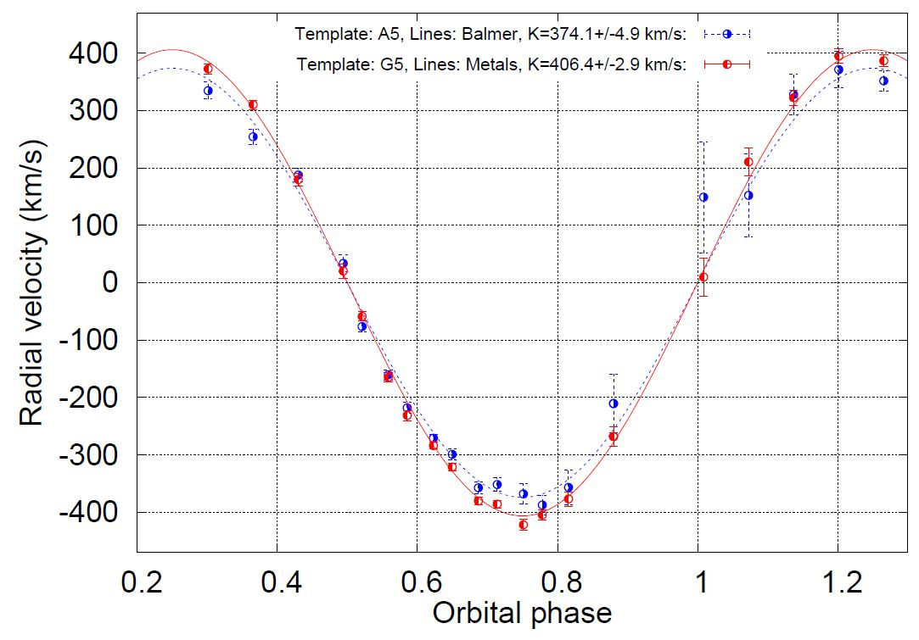
Pulsar state: neutron star mass
Mass measurements in the pulsar state: IRRADIATION
DK = 32 km/s; e.g.:
Mns = 1.5 → 2 Msun
Linares et al. (in prep.)
Radial velocities must be measured with care

Slide 10
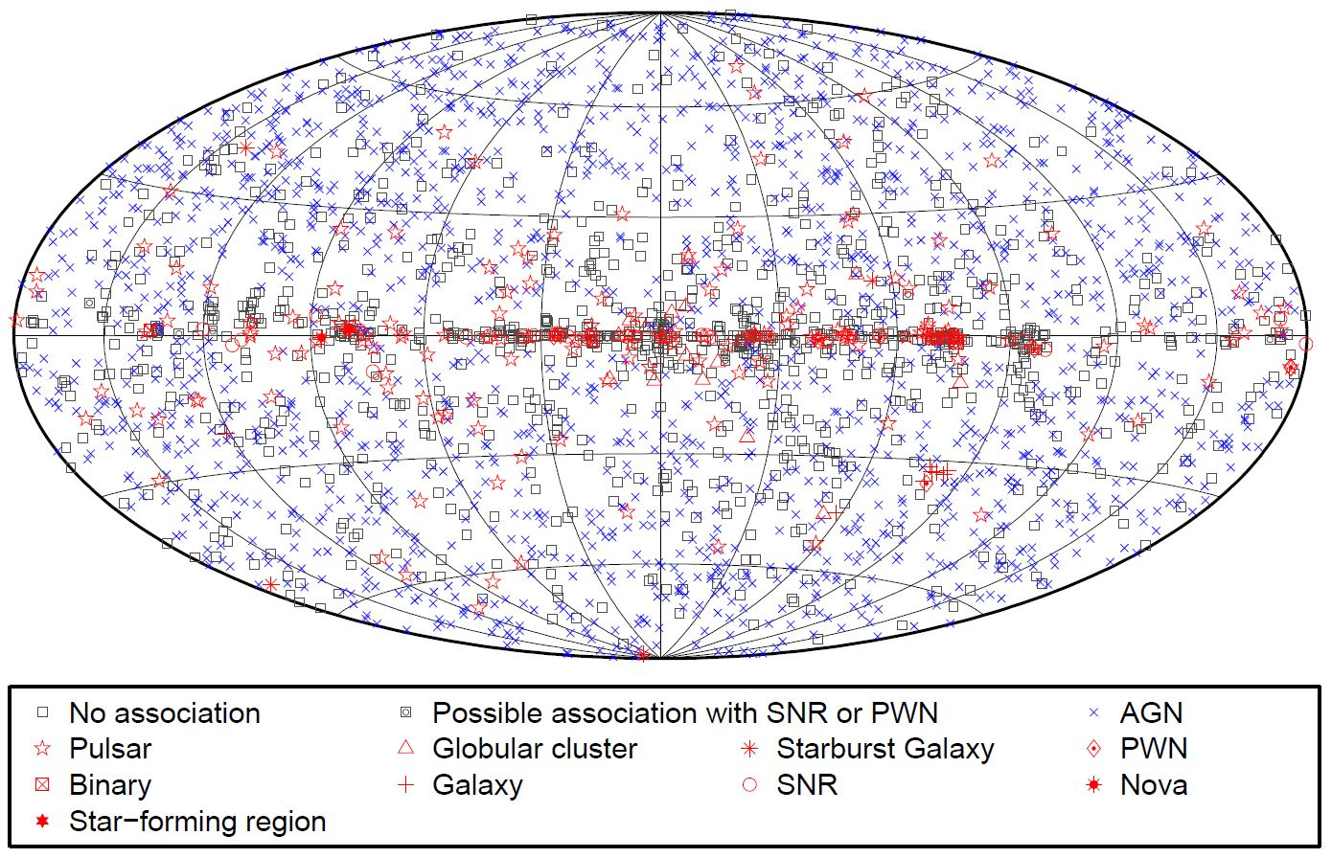
The Future is Bright
Fermi-LAT: driving force and discovery space
Acero et al. (2015)
More than a thousand unidentified GeV sources!

Slide 11
Summary & Conclusions
Take home: mode switching is ubiquitous in the disk state of redbacks
Hynes+
The X-ray luminosity of redbacks can vary by ×10⁶, defining three main states: outburst (10³⁴<L_{x}<10³⁷ erg/s; only in M28-I), disk (4×10³²<L_{x}<10³⁴ erg/s; seen in M28-I, J1023 & J12270) and pulsar state (10³¹<L_{x}<4×10³² erg/s; >7 redbacks detected).
All three accreting redbacks (M28-I, J1023 & J12270) have shown mode switching in the disk state (rapid transitions between disk-active, L_{x}=[3-5]×10³³ erg/s, and disk-passive, L_{x}=[6-9]×10³² erg/s, states).
All three accreting redbacks (M28-I, J1023 & J12270) have relatively high luminosities in the pulsar state (L_{x}>10³² erg/s; same true for J1723 & J2215).
The effects of irradiation must be carefully considered when measuring radial velocities in the pulsar state of redbacks.
Escher

Slide 12
Summary & Conclusions
Take home: mode switching is ubiquitous in the disk state of redbacks
Hynes+
IRRADIATION!
MODE
SWITCHING!
Unique probe of pulsar wind – magnetosphere – accretion flow
Escher

