Slide 1
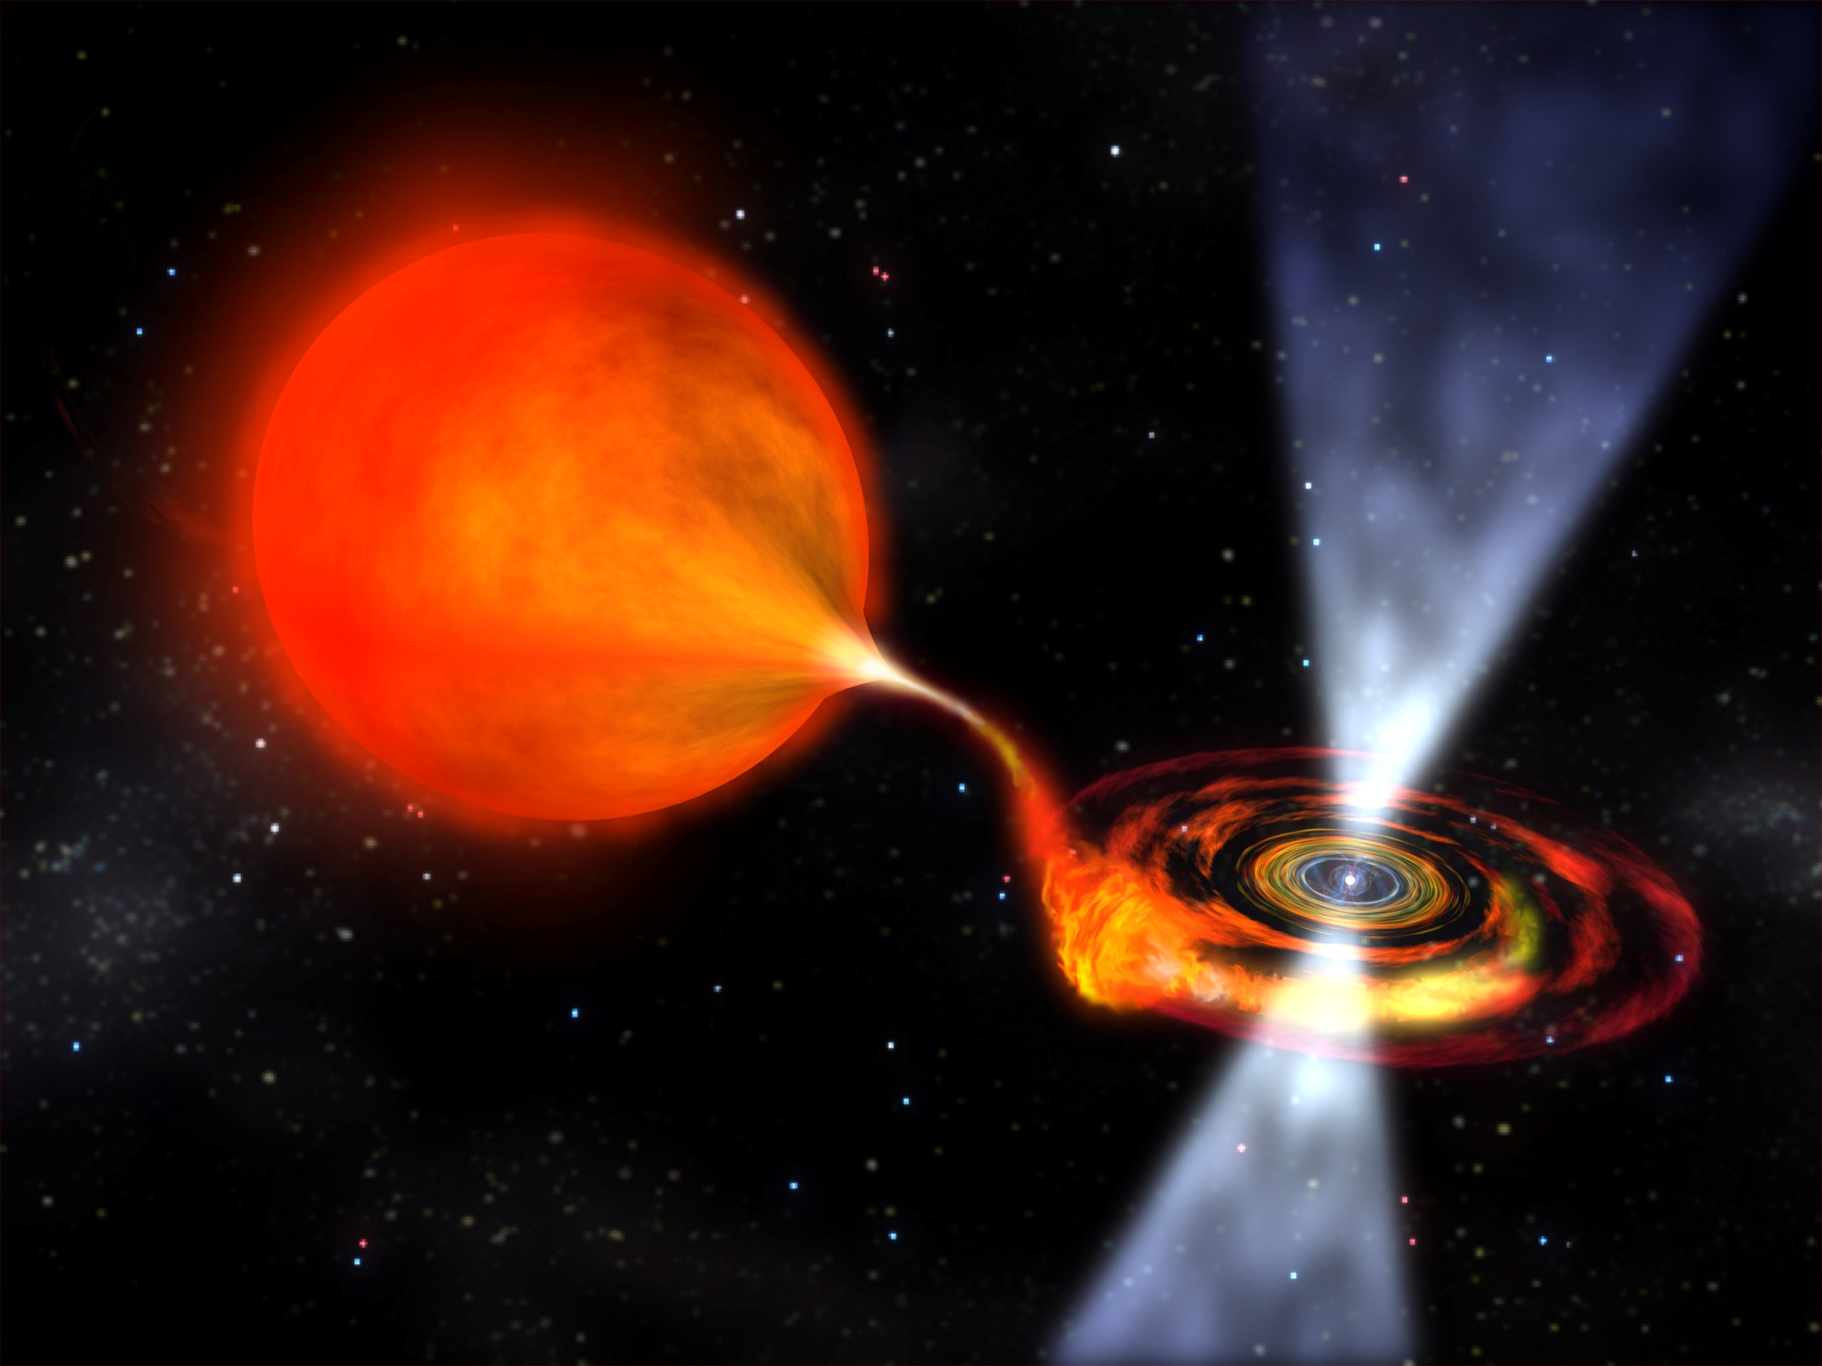
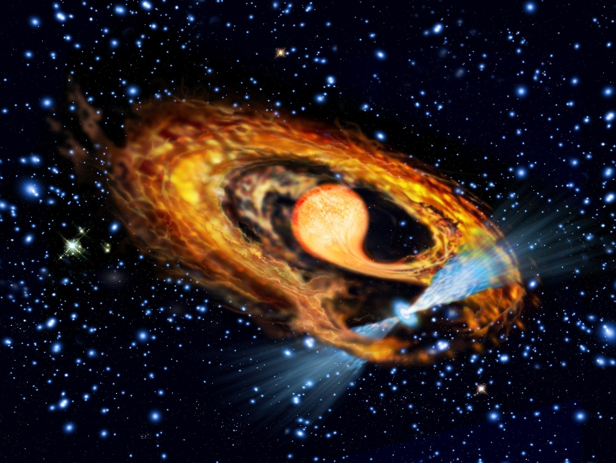
Is Radio−Ejection ubiquitous among
Accreting Millisecond Pulsar?
Luciano Burderi, University of Cagliari
Collaborators:
Tiziana di Salvo, Rosario Iaria, University of Palermo
Fabio Pintore, Alessandro Riggio, Andrea Sanna, University of Cagliari

Slide 2
The Radio-Ejection mechanism (Burderi et al. 2001, ApJ)
Pressure of a rotating magnetic dipole
Magnetostatic (inside light cylinder): P_{MAG} ≈ B² × r ⁻⁶
Radiative (outside light cylinder) ν_{RAD} 400 Hz: P_{PSR} ≈ B² Ω⁴ × r ⁻²
P_{DISC} ≈ dM/dt × r ^{−2.5}
accretor
P_{MAG} ≈ B² × r ⁻⁶
propeller
dM/dt
log p
radio-ejector
radio-ejector
P_{PSR} ≈ B² Ω⁴ × r ⁻²
Corotation Radius
Light-cylinder Radius
Roche-Lobe Radius
log r (from NS center)

Slide 3
The Radio-Ejection hypothesis
(Burderi et al. 2001, ApJ, Di Salvo et al. 2008, ApJ)
Outburst: accretion episode
Quiescence: radio ejection

Slide 4
Evidence of Radio-Ejection in Accreting Millisecond Pulsars
Orbital evolution:
q = m₂/m₁
dm₂/dt < 0 (Secondary loses mass)
dm₁/dt = − dm₂/dt (conservative case, no mass loss from the system)
Secondary star equation:
(dR₂/dt)/R₂ = n × (dm₂/dt)/m₂ (stellar index n = -1/3)
Driving mechanism GR angular momentum losses:
(dJ/dt)_{GR}/J_{ORB} ≈ − (32/5c⁵)(2π)^{8/3}(Gm₁^{5/3})q(1+q)^{-1/3}P_{ORB}^{−8/3}
Angular momentum conservation:
(dR_{RL2}/dt)/R_{RL2} ≈ 2 (dJ/dt)_{GR}/J_{ORB} − 2 (dm₂/dt)/m₂ × (5/6 – q)
Accretion condition:
(dR_{RL2}/dt)/R_{RL2} = (dR₂/dt)/R₂
For q <<1
dm₂/dt ≈ 1.5 m₂ × (dJ/dt)_{GR}/J_{ORB}

Slide 5
Evidence of Radio-Ejection in Accreting Millisecond Pulsars
IGR J1749.8-2921 (Papitto et al. 2011):
P_{SPIN} = 2.5 ms
P_{ORB} = 3.8 h
m₂ ≥ 0.17 M_{SUN} (for m₁ = 1.4 M_{SUN})
or
q³ ≥ f(m) (1+q)²/m₁ (f(m) = m₁sin(i)³q³/(1+q)² orbital mass function)
dm₂/dt ≈ 1.5 m₂ × (dJ/dt)_{GR}/J_{ORB}
L = (Gm₁/R₁) × (−dm₂/dt)
L ≥ (48/5c⁵)(Gm₁)^{5/3}(2π/P_{ORB})^{8/3}m₁^{1/3} f(m)^{2/3} (Gm₁/R₁) = L_{MIN}
L_{AVERAGE} = L_{OUT} × (Δt_{OUT}/Δt_{TOT})
decreases if the source is still in quiescence after the first outburst
If L_{AVERAGE} << L_{MIN} conservative evolution is IMPOSSIBLE!

Slide 6
Evidence of Radio-Ejection in Accreting Millisecond Pulsars
L_{MIN}

Slide 7
Results from timing of 5 outburst of SAXJ1808.4-3658 (1998−2015)
Delays of the time of ascending node passage of all the outbursts show a clear parabolic trend which implies a costant dP_{ORB}/dt, more than 10 times what is expected by conservative mass transfer from a fully convective and/or degenerate secondary (n ≈ -1/3) driven by GR (Di Salvo, 2008; Hartman, 2008) !
Orbital period increases:
dP_{ORB}/dt = (3.89 ± 0.15) × 10⁻¹² s/s
Burderi et al. 2009 using XMM and RXTE
2015
2011
2008
2005
2002
1998
2000

Slide 8
Theory of Dynamical (Orbital) evolution in SAXJ1808.4-3658
Following Di Salvo et al. (2008):
a) J_{TOT} conservation;
b) third Kepler's law;
c) AM losses by GR;
gives the orbital period derivative:

Slide 9
Predictions from Secular evolution
Following Di Salvo et al. (2008) we adopt:
a) J_{TOT} conservation;
b) contact condition: and
c) MB and GR angular momentum losses as driving mechanism
Highly non conservative mass-transfer is required by the Secular evolution to drive the high mass-transfer rate implied by the Dynamical evolution!

Slide 10
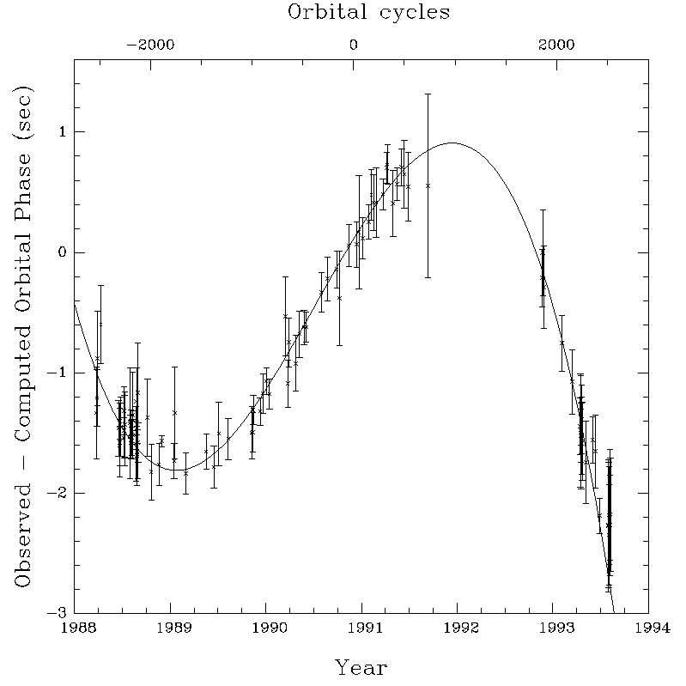
Hartman et al. (2008) and Patruno et al. (2011) proposed that magnetic activity in the companion is responsible for the orbital variability of SAXJ1808 – as discussed by Applegate & Shaham (1994) and Arzoumanian et al. (1994) to explain the orbital varability observed in PSR B1957+20 – and predicted that quasi-cyclic variability of P_{ORB} would reveal itself over the next few years, but…
Explaining the large observed dP_{ORB}/dt
∆ t ≈ 3.8 s
Sinusoid
P_{MOD}≈ 6 yr
∆ t ≈ 70 s
Parabola
T ≈ 17 yr
P_{MOD} ≥ 68 yr ?
Arzoumanian et al. (1994)

Slide 11
In the model of Applegate & Shaham (1994) variations of the quadrupole moment, ∆ Q, of the secondary istantaneously reflect (through the action of gravity) in ∆ P_{ORB}:
The Applegate & Shaham model for periodic orbital modulations
∆Q varies because of AM transfer between (internal) shells of the secondary caused by the action of a strong (internal) magnetic field.
This mechanism has a cost: the internal energy flow required to power the action of the magnetic field is (assuming a Roche Lobe filling secondary) :

Slide 12
Energy constrains in the Applegate & Shaham
For PSR B1957+20 a sinusoidal modulation is observed with P_{ORB}≈ 9.17 h, ∆P/P ≈ 1.0×10⁻⁷, P_{MOD}≈ 6 yr, m₁ = 1.4,
m₂ = 0.025.
For SAXJ1808.4-3658 no sinusoidal modulation is observed, although is possible to believe that what we observe is part of a sinusoid with P_{ORB}≈ 2.01 h, ∆P/P ≈ 72×10⁻⁷ and P_{MOD} ≈ 70 yr, m₁ = 1.56, m₂ = 0.08.
This gives:
dE/dt ≈ 3 ×10³⁰ erg/s = 7.5×10⁻⁴ L_{SUN} (PSR B1957+20)
dE/dt ≈ 8 ×10³² erg/s = 0.1 L_{SUN} (SAXJ1808.4-3658)

Slide 13
The tidal-dissipation Applegate & Shaham mechanism
For small secondaries the internal energy flow required to power the action of the magnetic field (dE/dt) cannot come from nuclear burning since L = m₂⁵ L_{SUN} and:
M₂ ≈ 0.025 M_{SUN} (PSR B1957+20)
M₂ ≈ 0.080 M_{SUN} (SAX J1808.4-3658)
Applegate & Shaham (1994) argued that the required power is provided by tidal dissipation in a sligthly asynchronous secondary (∆Ω/Ω ≈ 10⁻³).
Tidal power proportional to (R_{RL2}/R₂)⁹: drop vertically as R₂ R_{RL2}
The secondary is kept out of perfect corotation by the magnetic braking action of a strong stellar wind.
This mechanism operates in PSR B1957+20 because the companion underfills (80-90%) its Roche Lobe.
On the other hand, the companion of SAXJ1808.4-3658 fills its Roche Lobe, as testified by the accretion episodes, thus tidal dissipation cannot wok to power the Applegate & Shaham mechanism in this source.

Slide 14
a) Some degree of asynchronism could drive a tidal-dissipation Applegate & Shaham mechanism with orbital oscillations of few seconds amplitude. The power required is 10⁻³ ÷ 10⁻⁴ times less than the power required to produce the main (parabolic) modulation: dE/dt ≈ 10²⁹ ÷ 10³⁰ erg/s. b) The mass outflow induced by Radio-ejection is highly variable up to 30÷40% in line with the observed peak bolometric luminosity variations (see right panel below).
Since dP_{ORB}/dt ≈ −dm₂/dt these variations induce dP_{ORB}/dt variations of the same order.
Explaining the 7s delay observed in the 2011 outburst
∆ t ≈ 3.8 s
Sinusoid
P_{MOD}≈ 6 yr
2002
2011
1998
2005
2015
2008
Arzoumanian et al. (1994)
2000

Slide 15
Conclusions
Radio-ejection is a necessary outcome if accretion onto a rotating magnetic
dipole drops moving the truncation radius of the disc beyond the light cylinder.
Accreting Millisecond Pulsar are Transient: the onset of radio ejection during quiescence is likely.
Conservative orbital evolution driven by GR is excluded at least in IGR J1749.8−2921.
The large orbital period derivative detected in SAXJ1808.4−3658 implies a high
average mass transfer rate not compatible with a conservative scenario.
The tidal-dissipation Applegate & Shaham mechanism that produces
quasi-sinusoidal orbital period modulation works in PSR B1957+20 because the companion underfills its Roche Lobe and asinchronous
dissipation is possible.
The companion of SAXJ1808.4-3658 fills its Roche Lobe, and tidal dissipation cannot wok to power the Applegate & Shaham mechanism in this source.
The tidal-dissipation Applegate & Shaham mechanism could explain the small
discrepancy observed during the 2011 outburst (7s) that is comparable to the orbital
Fluctuations observed in PSR B1957+20.
Alternatively, fluctuations of the mass outflow induced by the onset of
Radio-ejection are proportional to fluctuations in dP_{ORB}/dt

Slide 16
That’s all Folks!
Thank you for your attention

